Slide 1
Assalamu Alikum Warahmatullah

Slide 2
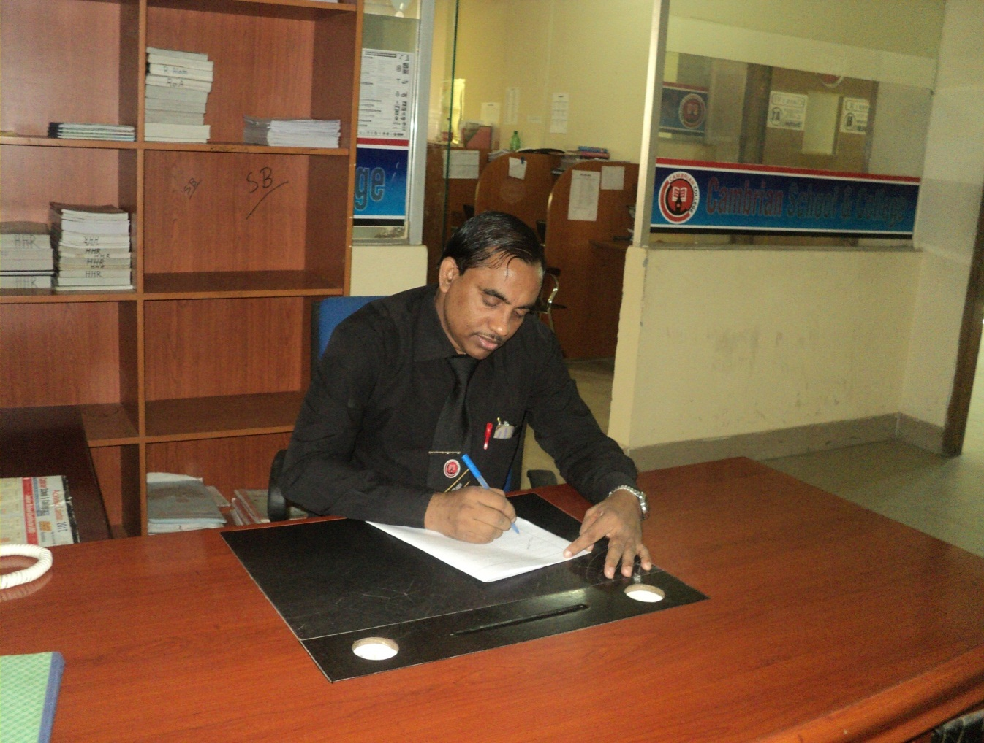
Md Hasan Hafizur Rahman
Senior Lecturer
Department of English
Cambrian School & College,Dhaka,
Class-Eight
English 1st Paper

Slide 3
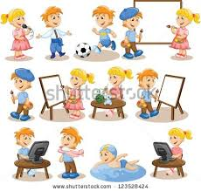
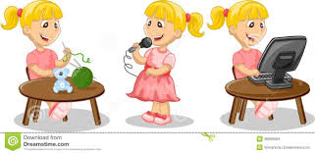
Hobbies

Slide 4
Our Today’s Lesson is-
A dialogue on
“Hobbies”

Slide 5
Learning outcomes
After we have studied this lesson we will be able to-
exchange greetings
ask and answer questions
achieve inspiration
write a dialogue.

Slide 6
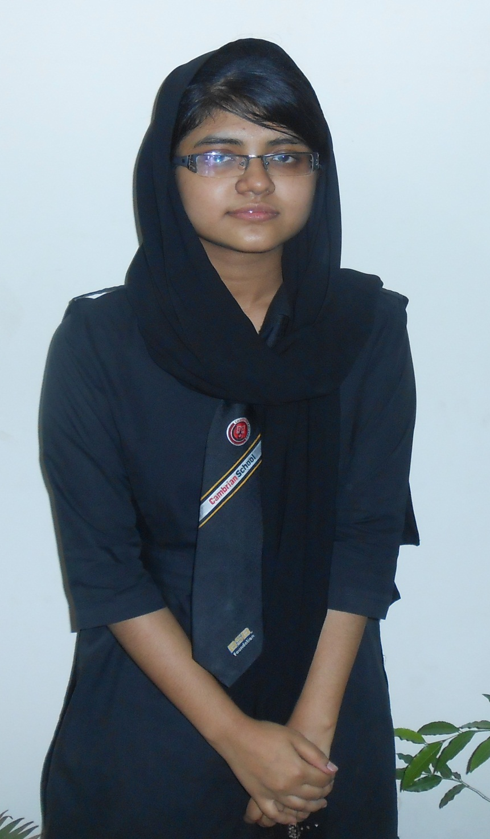
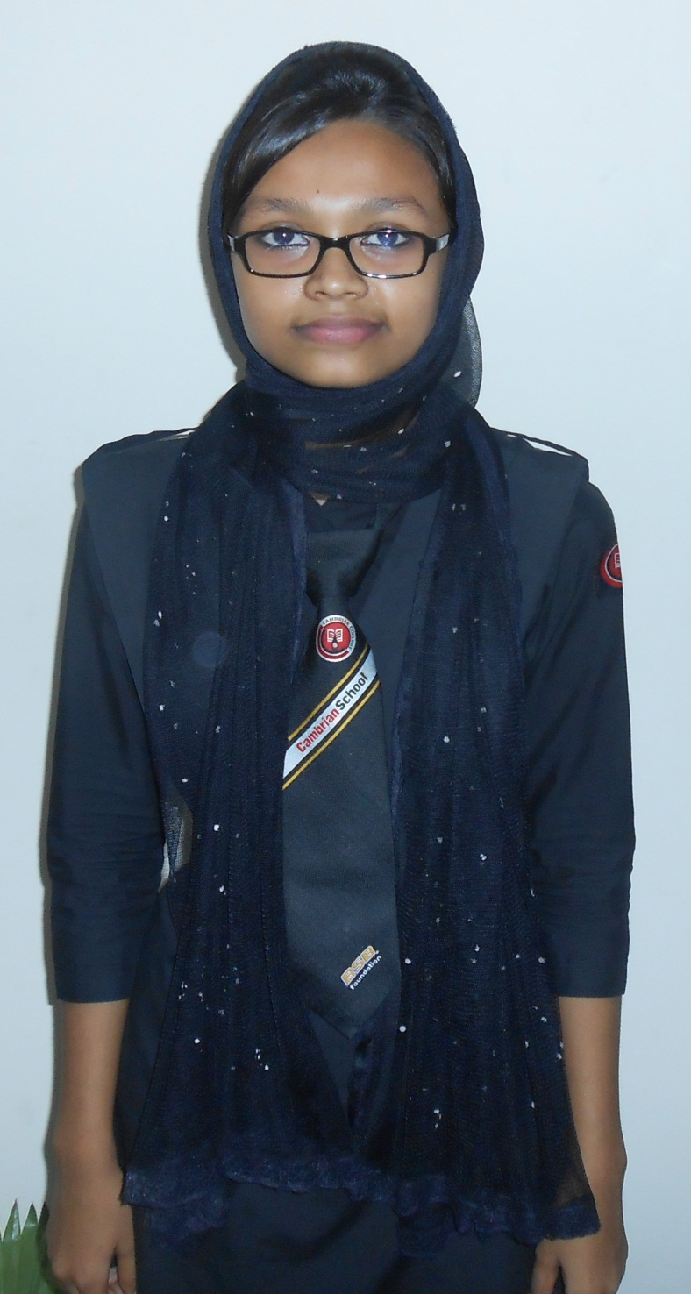
Sharmin
Shahida

Slide 7
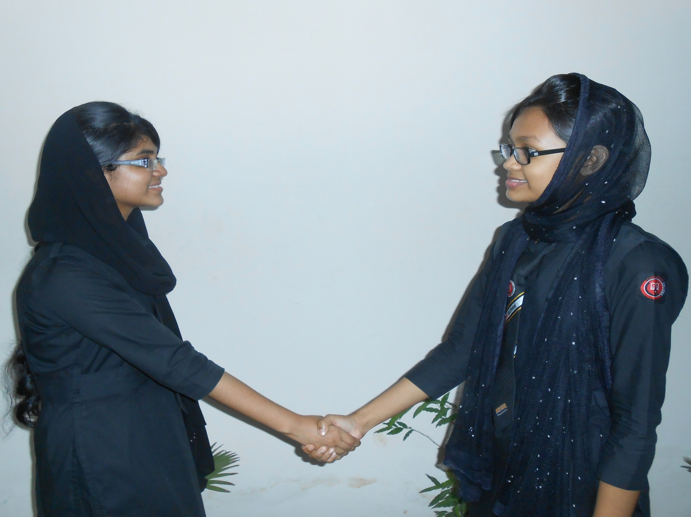
Assalamu Alaikum.
Walaikum Assalam.

Slide 8
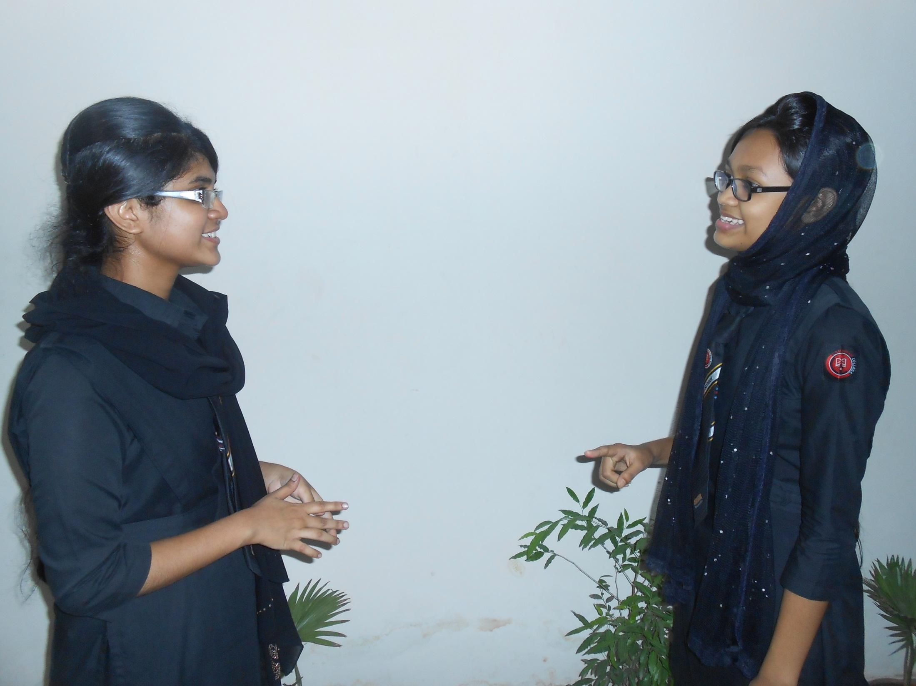
How do you do my friend?
Alhamdulillah, and you?

Slide 9
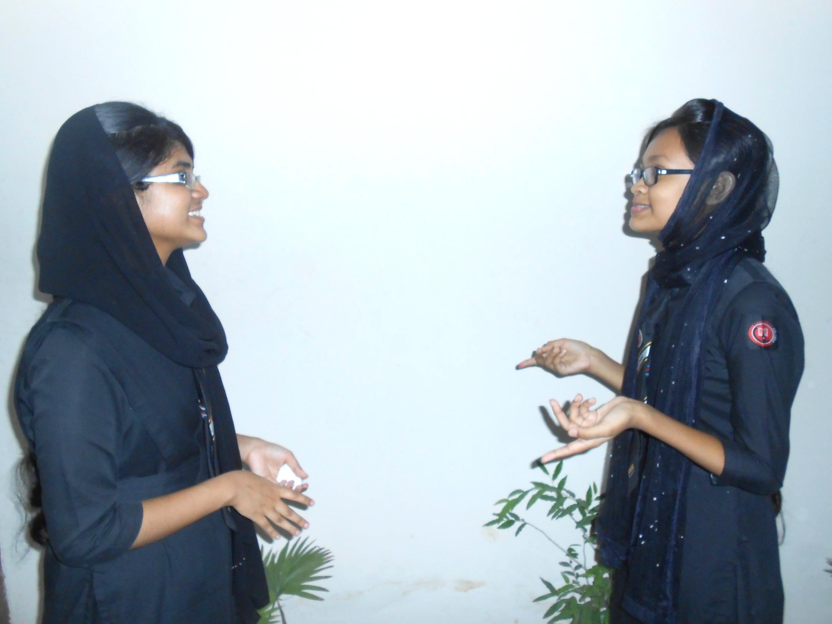
Also well.
Where are you going now?

Slide 10
I am going to a book shop.
Do you want to buy any book?

Slide 11
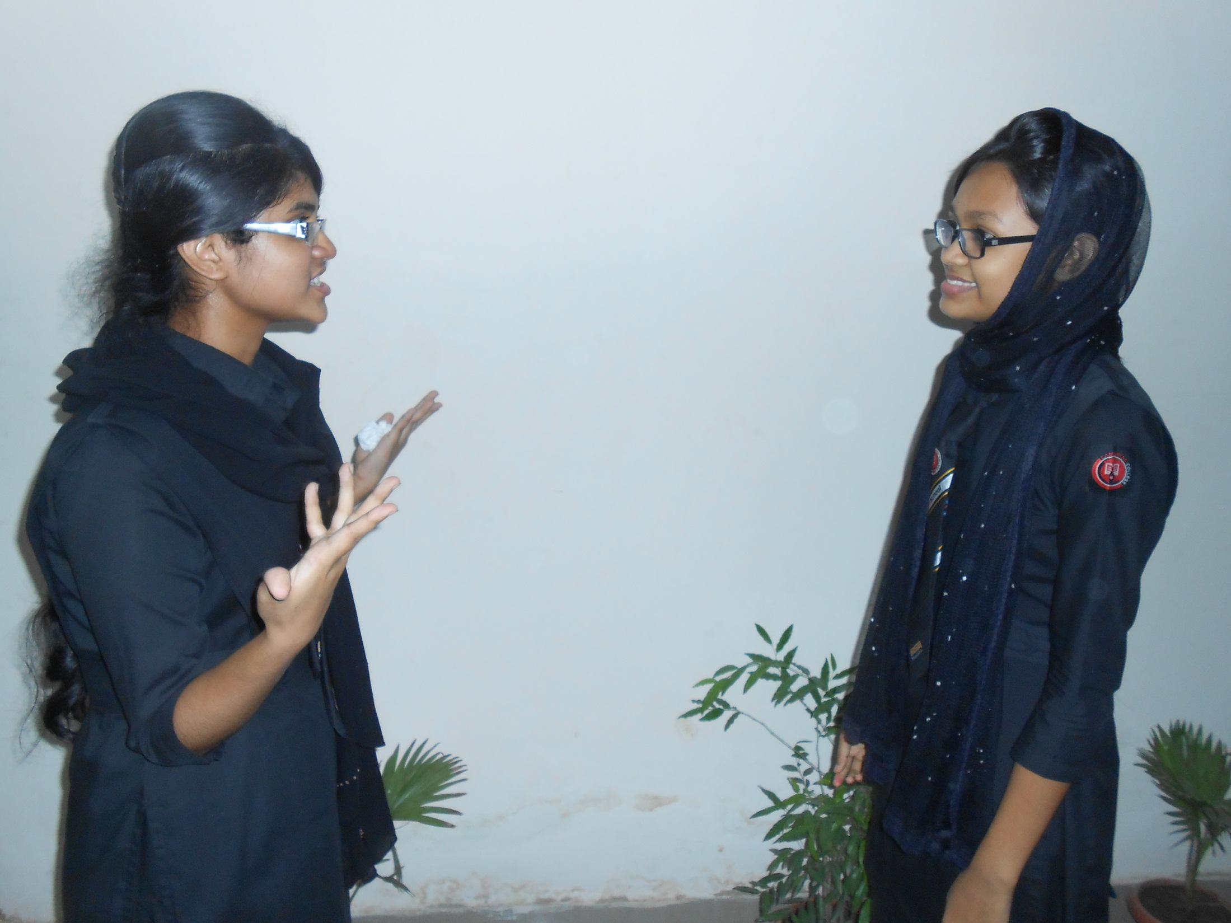
Yes, you are right. Very often I buy different kind of books.
Very often, but why?

Slide 12
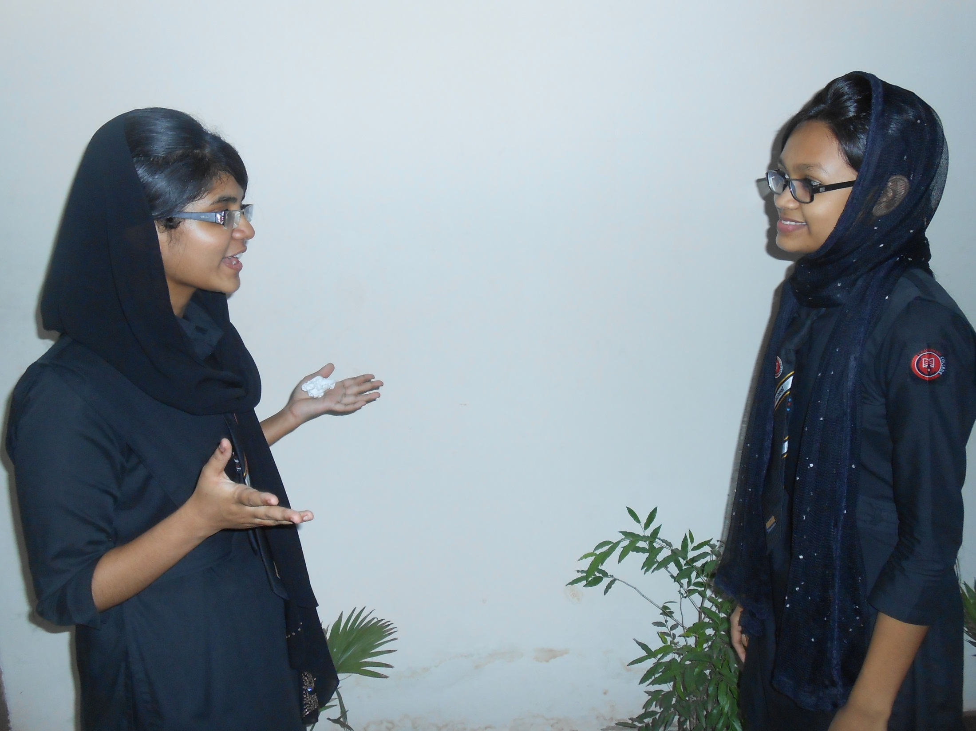
I like to read book very much.
Is it your hobby?

Slide 13
Yes, it is my hobby.
Why is reading your hobby?

Slide 14
I always find interest reading books as I can know many new things.
You have told the truth. It is undoubtedly a good hobby.

Slide 15
I think so.
Which book will you buy today?

Slide 16
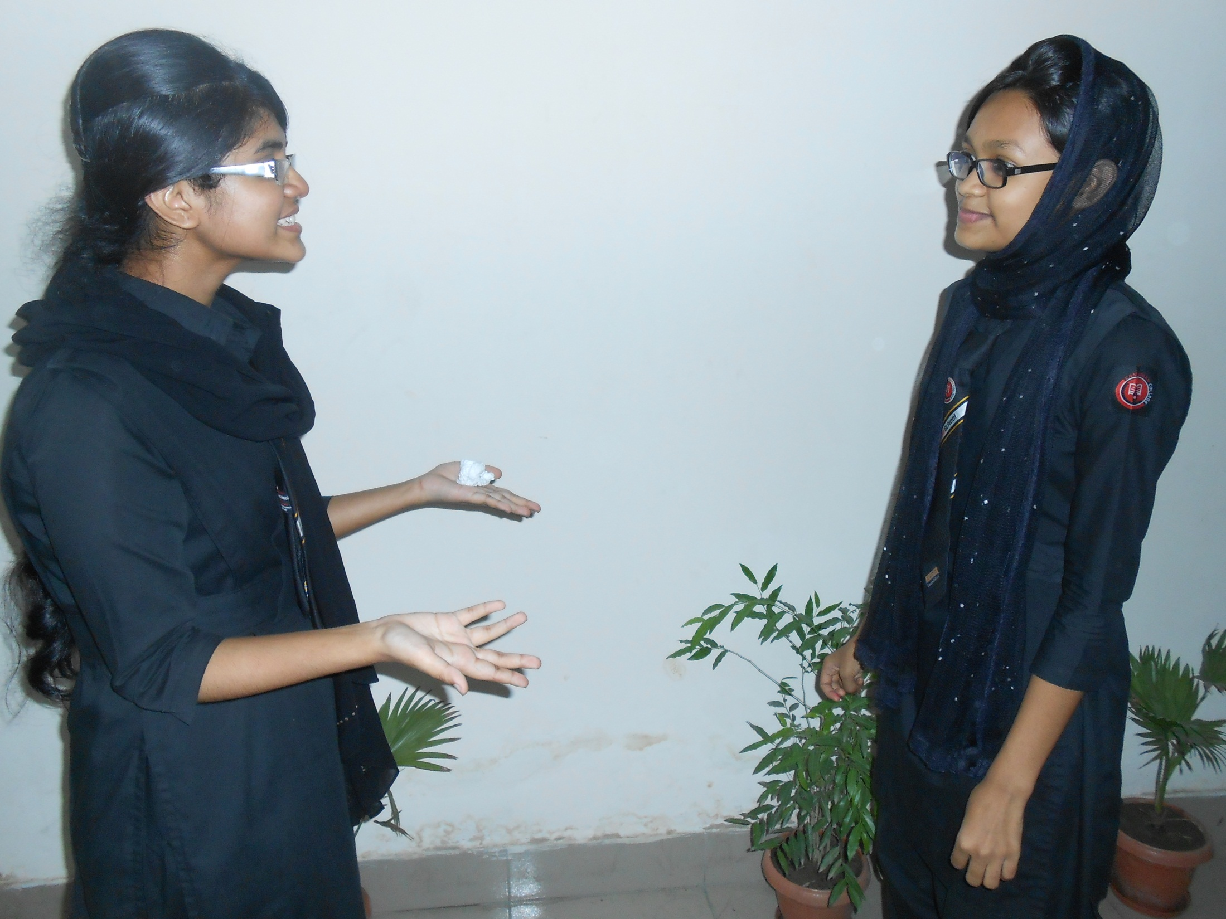
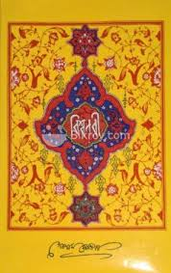
I will buy ‘Biswanabi’ by Golam Mostafa.
What is the characteristic of this book?

Slide 17
I heard from one of my teachers that it is the best book to know our prophet and Islam at a glance.
O I see.

Slide 18
But now tell me what is your hobby?
My hobby is travelling.

Slide 19
Do you feel interest in travelling?
Yes, it is very interesting to me because I can achieve practical knowledge by travelling.

Slide 20
When do you take travel?
Whenever I get opportunity.

Slide 21
Thank you for sharing your hobby.
Thank you also.

Slide 22
Pair Work
Every single pair is suggested
to write a dialogue on,
“ Hobbies”

Slide 23
Evaluation
Answer the following questions-
What is your hobby?
Why do you choose it?
What is the benefit of reading books?
How is travelling beneficial for us?

Slide 24
Homework
Write a dialogue with your friend about
“Hobbies”

Slide 25
Verse Universal
“Reading gives a man theatrical knowledge but travelling gives
a man practical knowledge”

Slide 26
Alallahu Khairan Hafezan wahua Arhamur Rahimin

